Slide 1

New Employee Benefits

Slide 2
Core Benefits
Division of Human Resources-Central Benefits Office

Slide 3
USC Benefits
The University of South Carolina offers eligible employees a comprehensive benefits package through the state's Public Employee Benefit Authority (PEBA) program. In addition, we offer voluntary benefits to supplement state coverage.
This is not a comprehensive overview of the benefits offered by USC and PEBA. For more additional information, please refer to our website and available resources.

Slide 4
Before You Choose a Plan
Visit PEBA’s website at www.peba.sc.gov to learn more about the Insurance Benefits offered at USC.
Contact USC Benefits Office if you have questions about enrollment or signing up for insurance at 803.777.6650

Slide 5

Core Health Insurance Benefits

Slide 6
State Health Plan
Self-funded insurance plan:
  Members’ and employers’ premiums are held in a trust fund, and these funds are used to pay claims.
  BlueCross BlueShield of South Carolina processes health claims.
  Express Scripts processes prescription claims.
Cost of the State Health Plan compares favorably to other plans.
  Learn more at peba.sc.gov/facts.

Slide 7
State Health Plan provider network
Worldwide coverage under Standard Plan and Savings Plan.
You pay copayments, deductible and coinsurance.
Network provider files claims and accepts the Plan’s allowed amount, even if its charges are higher.
  If you use an out-of-network provider, you may have to file claims and could be balance billed. You pay a higher coinsurance, too.
Use Find Care link under Resources at StateSC.SouthCarolinaBlues.com to find a network provider near you.

Slide 8
Terms to know
Annual deductible
The amount you pay for covered services before the health plan begins to pay.
Coinsurance
The percentage of the cost of health care you pay after meeting your deductible.
Copayments
The fixed amount you pay for a covered health care service.

Slide 9
Standard Plan versus Savings Plan
 | Standard Plan | Savings Plan
Annual deductible | You pay up to $515 per individual or $1,030 per family. | You pay up to $4,000 per individual or $8,000 per family.¹
Coinsurance² | In network, you pay 20% up to $3,000 per individual or $6,000 per family. | In network, you pay 20% up to $3,000 per individual or $6,000 per family.
Physician’s office visit³ | You pay a $15 copayment plus the remaining allowed amount until you meet your deductible. Then, you pay the copayment plus your coinsurance. | You pay the full allowed amount until you meet your deductible. Then, you pay your coinsurance.
¹If more than one family member is covered, no family member will receive benefits, other than preventive benefits, until the $8,000 annual family deductible is met.
²Out of network, you will pay 40% coinsurance, and your coinsurance maximum is different. An out-of-network provider may bill you more than the Plan’s allowed amount. Learn more about out-of-network benefits at peba.sc.gov/health.
³The $15 copayment is waived for routine mammograms, adult well visits, well woman visits and well-child visits. Standard Plan members who receive in-person care at a BlueCross-affiliated patient-centered medical home (PCMH) provider will not be charged the $15 copayment for a physician’s office visit. After Standard Plan and Savings Plan members meet their deductible, they will pay 10% coinsurance, rather than 20%, for in-person care at a PCMH.

Slide 10
Standard Plan versus Savings Plan
 | Standard Plan | Savings Plan
Outpatient facility/ emergency care^{1,2} | You pay a $115 copayment (outpatient services) or $193 copayment (emergency care) plus the remaining allowed amount until you meet your deductible. Then, you pay the copayment plus your coinsurance. | You pay the full allowed amount until you meet your deductible. Then, you pay your coinsurance.
Inpatient hospitalization | You pay the full allowed amount until you meet your deductible. Then, you pay your coinsurance. | You pay the full allowed amount until you meet your deductible. Then, you pay your coinsurance.
¹The $115 copayment for outpatient facility services is waived for dialysis services, partial hospitalizations, intensive outpatient services, electroconvulsive therapy and psychiatric medication management.
²The $193 copayment for emergency care is waived if admitted.

Slide 11
Standard Plan versus Savings Plan
 | Standard Plan | Savings Plan
Prescription drugs¹ 30-day supply/90-day supply at network pharmacy. | Tier 1 (generic): $13/$32 Tier 2 (preferred brand): $46/$115 Tier 3 (non-preferred brand): $77/$192 You pay up to $3,000 in prescription drug copayments. Then, you pay nothing. | You pay the full allowed amount until you meet your deductible. Then, you pay your coinsurance. Drug costs are applied to your coinsurance maximum. When you reach the maximum, you pay nothing.
¹Prescription drugs are not covered at out-of-network pharmacies. Specialty medications are limited to a 30-day supply per fill.

Slide 12
TRICARE Supplement Plan
Administered by Selman & Company.
Provides secondary coverage to TRICARE.
  Must be enrolled in TRICARE.
No deductibles, coinsurance or out-of-pocket expenses for covered services.
PEBA does not confirm eligibility.
  Eligible individuals must register with Defense Enrollment Eligibility Reporting System (DEERS).
  Must not be eligible for Medicare.

Slide 13



PEBA Perks
Free Value-based Benefits
Adult Vaccinations
Flu Vaccine
Behavioral Health Management
Cervical Cancer Screening
Colorectal Cancer Screening
Diabetes Education
Heart Health
Mammogram
Maternity Management-Breast Pumps
Nicotine Cessation
No-pay Copay
Preventive Screenings
Adult and Child Well Visits Benefits (exams and immunizations)
Weight Management
For more details visit www.PEBAperks.com

Slide 14
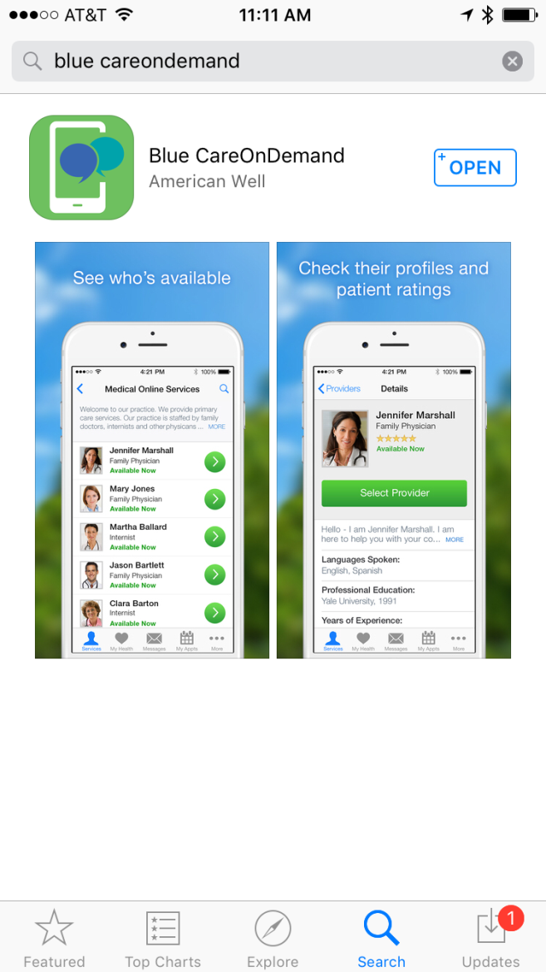


Telehealth: Blue CareonDemand
24/7/365 access to doctors to diagnose and treat common conditions
www.BlueCareOnDemandSC.com

Slide 15
Tobacco-use premium
Applies to State Health Plan subscribers only.
$40 per month for subscriber-only coverage.
$60 per month for other levels of coverage.
Automatically charged unless subscriber:
  Certifies as non-tobacco or e-cigarette user during online enrollment or via Certification Regarding Tobacco or E-cigarette Use form; or
  Certifies that all covered tobacco or e-cigarette users have completed the tobacco cessation program, Quit For Life.®

Slide 16
Managing Mental Health

Slide 17
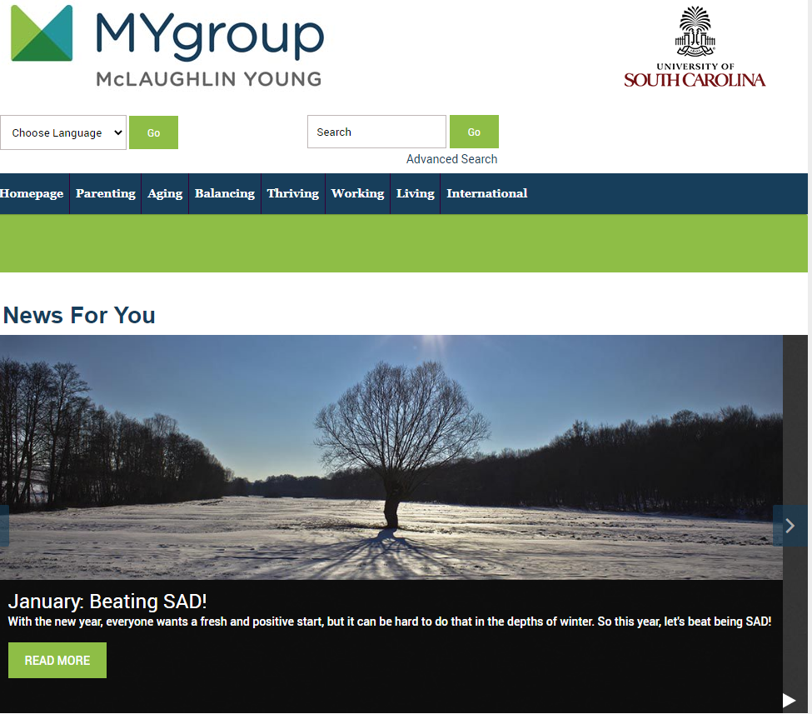
MyGROUP - Employee Assistance Program
Assessment & Counseling Services:
  Confidential services -Face to face, telephonic, and virtual options with a licensed clinician in your area
  Six sessions per individual, per issue
  Covers all benefits-eligible employees and permanent members in household, including college students away from home through age 26
Online Services
Legal Services
Financial Services
Phone: (800) 633-3353
Online: www.mygroup.com
  Click on My Portal Login
  Click on Work-Life
    Username: usc
    Password: guest
Notes:
MyGroup Employee Assistance Program
Assessment & Counseling Services:
Confidential services
Face to face, telephonic, and virtual options with a licensed clinician in your area
Six sessions per individual, per issue
Covers all benefits-eligible employees and permanent members of their household, including college students living away from home through age 26
Available Online: 7 focus areas on their site: Parenting, thriving, aging, balancing, living, working and international
Searchable databases for childcare referrals, pet sitting, attorneys, adoption, financial planners and volunteer opportunities
Over 100 streaming audio files and video files covering a range of health topics – monthly seminars
Savings Center: discount shopping program offering up to 25% discounts on name-brand items
Legal Services
Free Telephonic advise
• Free 30-minute legal consultation with a local attorney
• In most cases, 25% discount on ongoing legal services
• 100 legal forms available to download (such as wills, bill of sale, etc.)
• Online legal encyclopedia
Financial Services:
Free financial counseling appointments - bankruptcy, budgeting, buying a home, college savings, retirement planning
• Educational materials and financial worksheets
• 40 financial calculators available online
• ID theft recovery through credit monitoring
• Discounted credit reports
Tax Slayer

Slide 18
MERU HEALTH
Online health care provider that offers State Health Plan primary members an evidence-based program that is clinically proven to reduce anxiety, stress, depression and burnout.
No cost to members.
How it works - Meru Health
Companion Benefit Alternatives (CBA) - Meru Health

Slide 19

Dental Benefits
Administered by BlueCross
BlueShield of South Carolina

Slide 20
Dental plans
You have two options for dental coverage:
  Dental Plus; or
  Basic Dental.
When you make your election, you’ll choose Dental Plus or Basic Dental, not both.
There is a two-year commitment for dental coverage. You may enroll in or drop dental:
  During initial enrollment;
  During open enrollment in odd-numbered years; or
  Within 31 days of a special eligibility situation.

Slide 21
Dental Plus
Pays more and has higher premiums and lower out-of-pocket costs.
Has higher allowed amounts, which are the maximum amounts allowed by the plan for a covered service.
Network providers cannot charge you for the difference in their cost and the allowed amount.

Slide 22
Basic Dental
Pays less and has lower premiums and higher out-of-pocket costs.
Has lower allowed amounts, which are the maximum amounts allowed by the plan for a covered service.
There is no network for Basic Dental; therefore, providers can charge you for the difference in their cost and the allowed amount.

Slide 23
Summary of benefits
 | Dental Plus | Basic Dental
Diagnostic and preventive Exams, cleanings, X-rays | You do not pay a deductible. The Plan will pay 100% of a higher allowed amount. In network, a provider cannot charge you for the difference in its cost and the allowed amount. | You do not pay a deductible. The Plan will pay 100% of a lower allowed amount. A provider can charge you for the difference in its cost and the allowed amount.
Basic Fillings, oral surgery, root canals | You pay up to a $25 deductible per person.¹ The Plan will pay 80% of a higher allowed amount. In network, a provider cannot charge you for the difference in its cost and the allowed amount. | You pay up to a $25 deductible per person.¹ The Plan will pay 80% of a lower allowed amount. A provider can charge you for the difference in its cost and the allowed amount.
¹If you have basic or prosthodontics services, you pay only one deductible. Deductible is limited to three per family per year.

Slide 24
Summary of benefits
 | Dental Plus | Basic Dental
Prosthodontics Crowns, bridges, dentures, implants | You pay up to a $25 deductible per person.¹ The Plan will pay 50% of a higher allowed amount. In network, a provider cannot charge you for the difference in its cost and the allowed amount. | You pay up to a $25 deductible per person.¹ The Plan will pay 50% of a lower allowed amount. A provider can charge you for the difference in its cost and the allowed amount.
Orthodontics² Limited to covered children ages 18 and younger | You do not pay a deductible. There is a $1,000 lifetime benefit for each covered child. | You do not pay a deductible. There is a $1,000 lifetime benefit for each covered child.
Maximum payment | $2,000 per person each year for diagnostic and preventive, basic and prosthodontics services. | $1,000 per person each year for diagnostic and preventive, basic and prosthodontics services.
¹If you have basic or prosthodontics services, you pay only one deductible. Deductible is limited to three per family per year.
²There is a $1,000 maximum lifetime benefit for each covered child, regardless of plan or plan year.

Slide 25

Vision Care

Slide 26
State Vision Plan
Administered by EyeMed
Eye exams
Frames and lenses
Contact lens services and materials
Diabetic eye care benefit
Discounts on LASIK and PRK vision correction

Slide 27
Monthly Premiums
Monthly premiums for health, dental, and vision are available on the Insurance Benefits page of SC.edu and PEBA.sc.gov/monthly-premiums.

Slide 28

Life Insurance Benefits
Term-Life
Administered by MetLife

Slide 29
Employee Life Insurance Options
Basic Life
  $3,000 at no cost to all eligible employees under age 70
Optional Life Insurance
  Coverage up to three times salary, if enrolled within 31 days of employment
  Medical evidence required for additional coverage
  Maximum coverage level of $500,000
  Premium based on amount of coverage and employee’s age

Slide 30
Dependent Life – Spouse Insurance
Employee not enrolled in Optional Life
  New hire can enroll spouse for $10,000 or $20,000
  Premiums based on spouse’s age and coverage level
Employee enrolled in Optional Life
  Evidence of insurability required
    Up to 50 percent of employee’s Optional Life
    $100,000 maximum
  Accidental death and dismemberment benefits
  Suicide exclusion

Slide 31
Dependent Life - Child Insurance
Dependent Life-Child
  $15,000 per child
  Premiums of $1.26 per month, regardless of number of children covered
  Can enroll eligible children throughout the year without medical evidence of good health

Slide 32

Long Term Disability Benefits
Administered by The Standard Insurance Company

Slide 33
Basic Long-Term Disability
Premiums paid by employer
Employee automatically enrolled with selection of eligible health plan
Helps protect a portion of your income if you become disabled as defined by the Plan
62.5 percent benefit, up to $800 per month
90-day waiting period

Slide 34
Supplemental Long-term Disability
Benefit is 65 percent of monthly salary, up to $8,000 per month
Choice of two plans
  90-day benefit waiting period
  180-day benefit waiting period

Slide 35

MoneyPlus Benefits
Administered by ASIFlex

Slide 36
MoneyPlus
Pretax premiums
Medical Spending Account (MSA)
Dependent Care Spending Account (DCSA)
Health Savings Account (HSA)
Limited-use Medical Spending Account

Slide 37
PEBA Insurance Benefits Enrollment

Slide 38
Hcm Peoplesoft Benefits enrollment process
Eligible employees may refuse or enroll in state insurance benefits within 31 days of their date of hire.
Enrollment process is initiated through the university's HR/Payroll system in Employee Self Service.
Receive an email notification to get started.
  Need USC username and password.
  Unable to locate the email, check your spam and junk folders.
If the enrollment is not completed within 31 days of your hire, you will miss your opportunity for initial enrollment.
  Next opportunity to enroll will be during open enrollment (October for most benefits) or due to a qualifying life event, whichever occurs first.
After this initial enrollment, your insurance benefits will be managed and renewed using PEBA’s MyBenefits online enrollment system. Follow these instructions to Set up a New MyBenefits Account [pdf].

Slide 39
MyBenefits
Secure, online insurance account access
To register for MyBenefits, you will need the following:
  Benefits identification Number
  Last 4- digits of your Social Security number
  Date of birth
MyBenefits flyer details how to register

Slide 40
Supplemental Insurance Benefits
Ward Services

Slide 41
Supplemental Insurance
University Life/Long-Term Care Insurance
  A universal life benefit in which the premiums are locked in at the purchase age.
  Includes a long-term care benefit – 4% of the death benefits per month.
  Available for employees, spouses, children, and grandchildren.
Short-Term Disability Insurance
  Paycheck protection that pays if a policy holder is out on disability for sickness or injury.
  90-day benefit with a 14-day elimination period.
  Benefit can be up to 60% of the employee’s normal pay.
  Available for employees only.

Slide 42
Supplemental Insurance
Critical Illness/Cancer Insurance
  Lump sum benefit ($5,000-$30,000) for a critical illness diagnosis (heart attack, stroke, cancer + 28 other illnesses).
  Available for employees and spouses.
Accident Insurance
  Pays benefit, in the event of an accident, based on a schedule of different events and treatments.
  Available for employees, employee and spouse, employee and children, or full family.

Slide 43
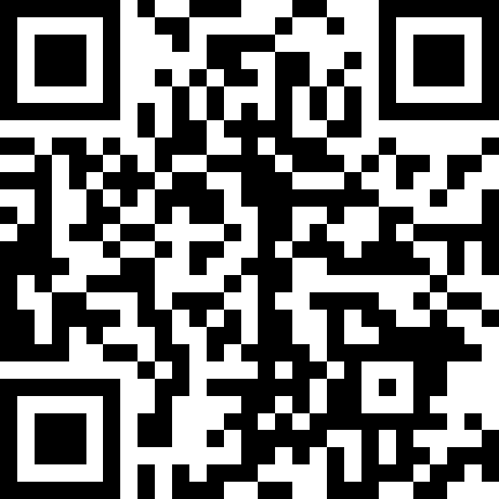
Supplemental Insurance Enrollment
Initial Enrollment Process
  Eligible employees must enroll within 30 days of their date of hire
  Processed through Ward Services, a third-party enrollment vendor
  Schedule a one-on-one meeting
    Call 844.533.2022 for online support
    Receive a confirmation and reminder from AppointmentPlus
  If you do not complete enrollment within 30 days of your hire, you will miss your opportunity for initial enrollment. Your next opportunity to enroll will be during Ward Services open enrollment period.

Slide 44
Auto and Home Insurance
Administered by Travelers Insurance Company
Available to employees and members of their household
Premium
  May be payroll deducted or
  Monthly withdrawals from a checking or savings account
Free quotes
  1.800.842.5936
  Travelers Insurance Company

Slide 45
Contact Information
  University Life/Long-Term Care Insurance & Critical Illness/Cancer Insurance:
  Trustmark website
  Short-Term Disability and Accident Insurance:
  Colonial Life website
  Auto and Home Insurance:
  Traveler's website

Slide 46

Retirement Benefits

Slide 47
Retirement Plans
Defined Benefit Plans
  South Carolina Retirement System (SCRS)
  Police Officer Retirement System (PORS)
Provides a monthly annuity retirement
  Benefit is based on a formula and not the account balance
    Average final compensation
    Years of service
    1.82% benefit multiplier
South Carolina Retirement System Investment Commission (RSIC)
  Invests the funds
Professional Investment Managers
  Approved by the RSIC
  Manage the portfolios

Slide 48
Retirement Plans
Defined Contribution Plan
  State Optional Retirement Program (ORP)
    Free to invest your funds within the plan’s investment options.
    Assume all investment risk.
    5% employer contribution.
    Account balance is portable.
    Transfer assets to another eligible retirement account .
      Terminate all covered employment.
      Reach age 59 ½ .

Slide 49
Member Contribution
Retirement Plan | Member Contribution Rate
SCRS | 9% of earnable compensation
State ORP | 9% of earnable compensation
PORS | 9.75% of earnable compensation

Slide 50
Selecting a Plan
Receive email from PEBA’s website- Member Access
  Must respond to email within 30 days or
  Default into SCRS

Slide 51
Member Access
Secure, online retirement account access
To register for Member Access, you will need the following:
  Last name
  Social Security number
  Date of birth
  A valid email address
Member Access flyer details how to register

Slide 52
Important Reminders
You are responsible for your benefits
Enrollment is not automatic
  Elections must be made within 30 days of being hired for retirement and 31 days for insurance or
  Special eligibility event
Complete insurance benefits eForm in PeopleSoft
  If you are not enrolling in coverage, you must affirmatively refuse all coverage.
For detailed information about benefits visit PEBA or USC’s websites.

Slide 53
Contact Information
  For most benefits questions:
  BENEFITS@mailbox.sc.edu
  Website and more resources:
  USC: Benefits - Human Resources | University of South Carolina (sc.edu)
  PEBA: Home | S.C. PEBA (sc.gov)
  Telephone:
  USC Benefits Office: 803.777.6650
  PEBA: 803.737.6800 or 888.260.9430

Slide 54
Supplemental retirement Plans

Slide 55
Voluntary Retirement Plans
South Carolina Deferred Compensation
  Payroll deducted
  401k and 457 plan options
  Before tax or after-tax options
  Contact Empower to enroll
403(b) Supplemental Retirement Benefit Program
  Sponsored by USC
  Contributions can be pre-tax, after-tax Roth, or both
Log into the Retirement@Work portal with your USC username and password to start the enrollment process
  Contact vendor to complete enrollment process

Slide 56
Thank You!
USC Division of Human Resources- Benefits Team & OPD
HUB International and Ward Services
Empower
TIAA
USC Payroll Department

