Slide 1
University of South Carolina
BLACK FACULTY CAUCUS
June 2021- May 2022 CELEBRATIONS

Slide 2
Books

Slide 3

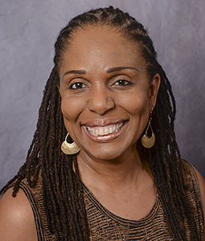
Dianne ”Dinah” Johnson
English

Slide 4

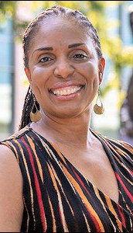


Slide 5

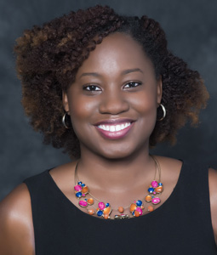
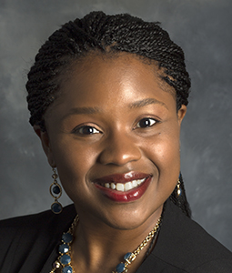
Kamania Wynter-Hoyte
Instruction & Teacher Education
Eliza Braden
Instruction & Teacher Education

Slide 6
Promotions

Slide 7

Eliza Braden
Instruction & Teacher Education
Associate Professor WITH Tenure

Slide 8
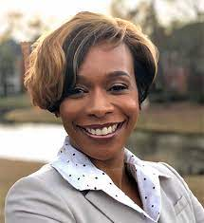

Tisha Felder
Nursing
Associate Professor WITH Tenure

Slide 9
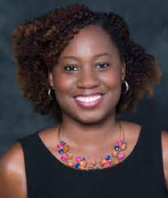
Kamania Wynter-Hoyte
Instruction & Teacher Education
Associate Professor WITH Tenure

Slide 10
Awards

Slide 11

We Be Lovin’ Black Children:
Learning to Be Literate About the African Diaspora
2022
Society of Professors of Education
Outstanding Book Award

Slide 12
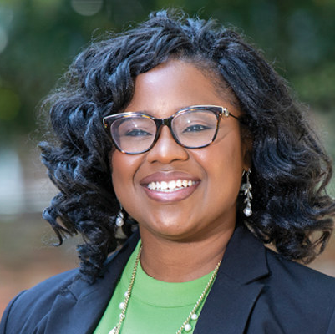
Eliza Braden
Instruction & Teacher Education
2021
Mungo Undergraduate Teaching Award

Slide 13
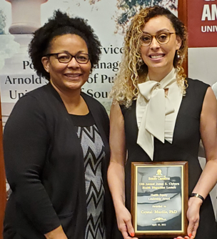
Coretta Jenerette
College of Nursing
UofSC College of Nursing
2022 Best Research Mentor

Slide 14
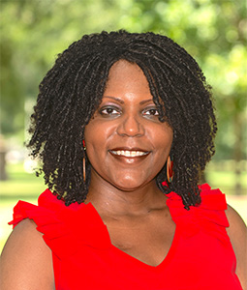
Toby Jenkins-Henry
Higher Education & Director Museum of Education
2022 Individual Leadership Award
National Association of Diversity Officers in Higher Education

Slide 15
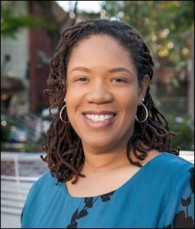
Qiana Whitted
Professor of English
Interim Associate Dean for College Initiatives and Interdisciplinary Programs in the College of Arts & Sciences
2022
Russell Research Award for Humanities and Social Sciences

Slide 16
Grants

Slide 17
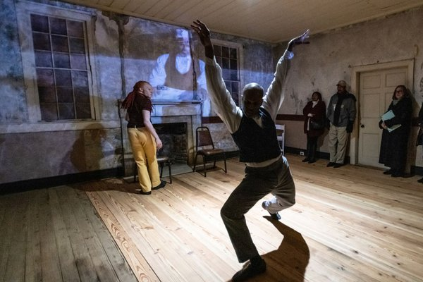
Wideman-Davis Dance
Mellon Foundation “Monuments Projects” grant
expand upon the Migratuse model with three, six-month residencies in cities across the South that involve local communities and engage live audiences in intimate antebellum histories told through dance.

Slide 18
Leadership & Honors

Slide 19
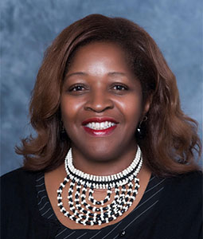
Gloria Boutte
Instruction & Teacher Education
Associate Dean, Diversity Equity & Inclusion
2022 Fellow of the
American Educational Research Association

Slide 20
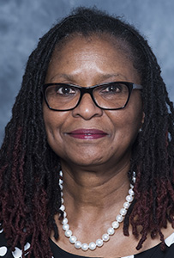
Fenice Boyd
Instruction & Teacher Education
Elected as Vice President of the Literacy Research Association (LRA)

Slide 21
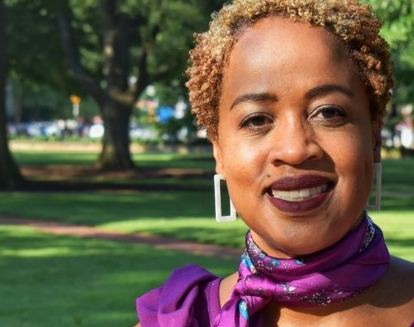
Michelle Bryan
Educational Studies
Associate Vice President in the Office of Diversity, Equity and Inclusion

Slide 22
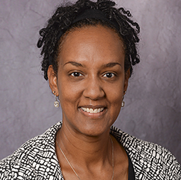
Tracey Weldon
English
Dean, Graduate School &
Vice Provost for
Graduate Education

