Slide 1


Student Chapter

Slide 2
Agenda
Executive Committee
What is AWM?
This Student Chapter...
Our Chapter's Vision and Goals
Upcoming Events
How can you get involved?
Contact us
Networking, Food & Drinks!

Slide 3
Executive Committee
Dr. Paula Vasquez, Faculty Advisor
Swati, President
Shreya Sharma, Vice-President
Ashita Tripathi, Treasurer
Ainsley McLaughlin, Secretary

Slide 4
What is AWM?
AWM or Association for Women in Mathematics is a non-profit organization founded in 1971.
The idea was to create a space in which women can thrive in their mathematical endeavors,
To promote equitable opportunities and treatment of women and others of marginalized genders and gender identities across the mathematical sciences.

Slide 5
Gender Gap in STEM
Significant gender gap with women constituting 28% of workforce.
24% in United States, 17% in European union, 16% in Japan, 14% in India.
Source: The Gender Gap in STEM: Still Gaping in 2023 https://professionalprograms.mit.edu/blog/leadership/the-gender-gap-in-stem/

Slide 6

This Student Chapter...
Was founded in 2017 by a group of students at USC Math department.
Reviving it after COVID.

Slide 7
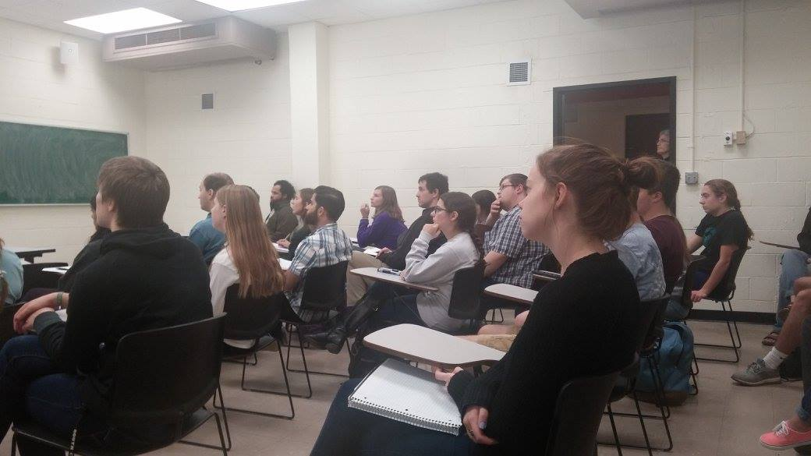
Graduate Fair, 2018

Slide 8
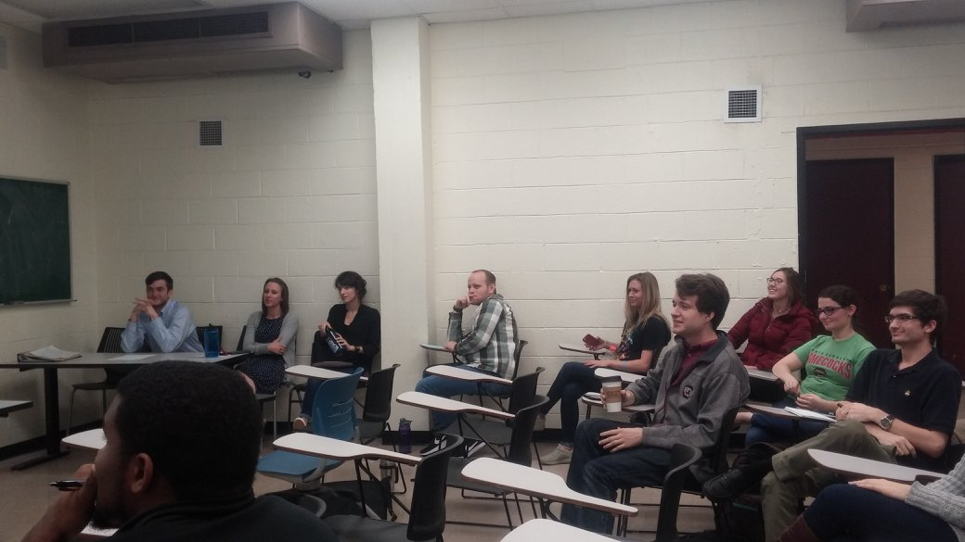
Graduate Fair, 2018

Slide 9

Our Student Chapter's Vision and Goals
A Strong, Diverse, and Inclusive Math Community
Aims to organize events for community building.
Provide learning opportunities to underrepresented groups and gender minorities in math.
Create a supportive network.
Promote gender equality.
Research and Advocacy.

Slide 10
Upcoming Events
Welcome Event (Today!)
Integration Bee Contest
Talk by a Guest Speaker
Movie Night
Graduate School Panel
Game Night
Ice-Cream Social and Tea-Time!

Slide 11

How can you get involved?
Become a part of the community by sending a membership request to us on Garnet Gate.
Attend meetings and events.
Promote AWM in your community.
Contribute ideas and initiatives.
Connect on Instagram.

Slide 12

Contact us
Email: awm.usc@gmail.com
Website: https://sc.edu/study/colleges_schools/artsandsciences/mathematics/beyond_classroom/awm/index.php
Instagram: @AWM_USC
Garnet Gate.

Slide 13
Thank You!!!

Slide 14


