Slide 1
Communicating the value of tourism

Slide 2

Study Overview
These findings and recommended actions are based on a nationwide study of tourism advocacy planning efforts.
In-depth interviews with 26 state-level destination and advocacy association leaders were conducted.
Notes:
SPEAKER NOTES
The work shared here resulted from a study conducted by Dr. Ashley Schroeder and Dr. Whitney Knollenberg.
They conducted interviews with 26 state level tourism leaders to better understand how we can plan for advocacy efforts.
The emphasis of this work in on how we can effectively plan for advocacy efforts, not necessarily the outcomes of advocacy.
The findings presented today focus on how communicating the value of tourism through advocacy.

Slide 3

SUCCESS IN ADVOCACY
Advocacy ensures that destination community stakeholders understand, prioritize, and support the value of tourism.
Keys to successful advocacy:
Proactive efforts
Broad and diverse communication
Strategic and unified
A proactive tourism advocacy plan
Notes:
SPEAKER NOTES:
To achieve this understanding, the tourism industry needs to be proactive in its efforts to communicate the value of tourism to a broad, diverse range of stakeholders.
Destination leaders need to be strategic and unified in these communication efforts, through proactive advocacy actions. Use these Actionable Advocacy Insights to develop and implement your destination’s proactive advocacy planning actions.

Slide 4

Let’s start with the basics and define advocacy.
Defining advocacy allows us, as an industry, to work from a unified understanding of what advocacy entails in order to more effectively increase support for tourism.
Notes:
SPEAKER NOTES:
When destination community stakeholders understand the value of tourism, they prioritize and support the tourism industry.

Slide 5
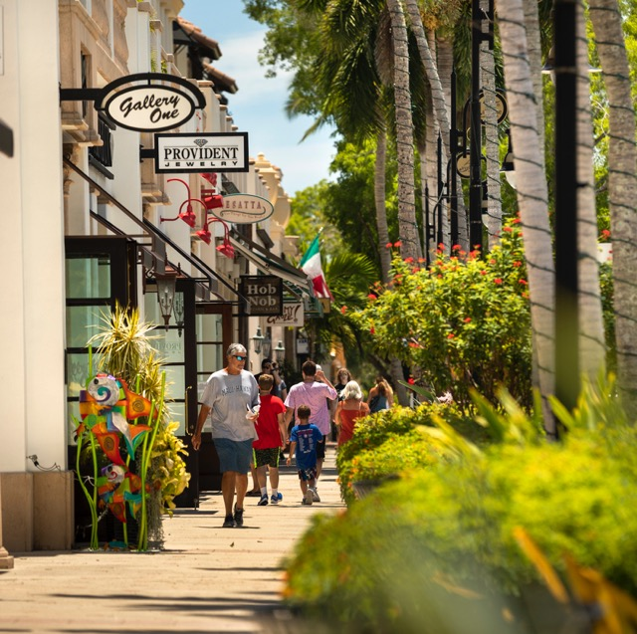
Defining advocacy CAN BE COMPLICATED
Lobbying: “For so many years our state travel director and our department heads didn't lobby the legislature. It was almost like they felt like it was an ethics issue.”
Educating: “Education, every day all day.”
Collaborating: “Working together for a common goal that will help improve our industry.”
Promoting: “Protecting and promoting the industry.”
Notes:
SPEAKER NOTES:
Interviews with 26 state level tourism leaders revealed many different definitions of advocacy.
The quotes from these interviews shown here reveal many definitions focus on only one element of advocacy.
This limits how many organizations can participate in advocacy.
None of these definitions establish an outcome for advocacy actions, which can result in different expectations and priorities.

Slide 6

Without a unified definition, the benefits of advocacy might not be realized
“Sharing the work we do so our stakeholders understand the value and importance of tourism”
“Creating partnerships with local stakeholders to create champions in the tourism space”
“Getting people…to believe that tourism exists”
These definitions illustrate that advocacy should center on communicating the value of tourism to stakeholders.
Notes:
SPEAKER NOTES
Here are several examples of state level leaders who define advocacy as communicating the value of tourism to stakeholders.
Defining advocacy allows us, as an industry, to work from a unified understanding of what advocacy entails in order to more effectively increase support for tourism and the benefits tourism brings to destination communities.

Slide 7

IT’S Time to Take action
Short-Term
Establish and share your definition of advocacy with your board, employees, and other stakeholders.
Mid-Term
Diversify your pool of potential advocates and communicate the importance of advocacy to them.
Long-Term
Develop an advocacy plan that prioritizes strategies for communicating the value of tourism.
Notes:
SPEAKER NOTES:
Here is an ”advocacy planning to do” list for us.
These actions will help set a foundation of advocacy based on the definition of communicating the value of tourism to stakeholders.

Slide 8

CONVERSATION STARTERS
Where do we need to document our definition of advocacy?
Who are our current advocates?
Who should be on included on a team to create a plan for advocacy?
Notes:
SPEAKER NOTES:
These topics of conversation are designed to help us start implementing our “advocacy planning to do list” (strategies on the previous slide).
Let’s take a few minutes to talk through each of these.

Slide 9



ABOUT THE National advocacy study
Purpose: To identify best practices in advocacy planning among tourism industry organizations.
Goal: To advance knowledge of tourism advocacy planning.
Overview: This study provides insights into the competencies, practices, and resources of tourism organization leaders who engage in advocacy.
Methods:
Interview and survey data were collected from 2019 - 2021 to inform this Actionable Advocacy Insights series.
26 in-depth phone interviews with state-level destination and advocacy association leaders.
205 online survey responses from local-level destination leaders.

Slide 10
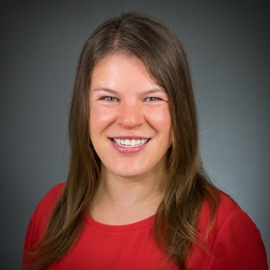
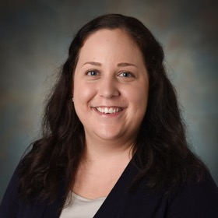


Contact us
Whitney Knollenberg, Ph.D.
Associate Professor
Department of Parks, Recreation, and Tourism Management
North Carolina State University
wgknolle@ncsu.edu
Ashley Schroeder, Ph.D.
Research Lead
Richardson Family SmartState Center for Economic Excellence in Tourism
Assistant Professor
School of Hotel, Restaurant, and Tourism Management
University of South Carolina
as232@mailbox.sc.edu
Department of Parks, Recreation and Tourism Management

Slide 11
acknowledgements
In addition to the study participants, we would like to give special thanks to the following individuals and organizations for their support of this research: Hailey Post, Ann Savage, Shannon Stover, Dr. Mandi Stewart, Southeast Tourism Society, Travel and Tourism Research Association, and American Society of Association Executives.

